Slide 1
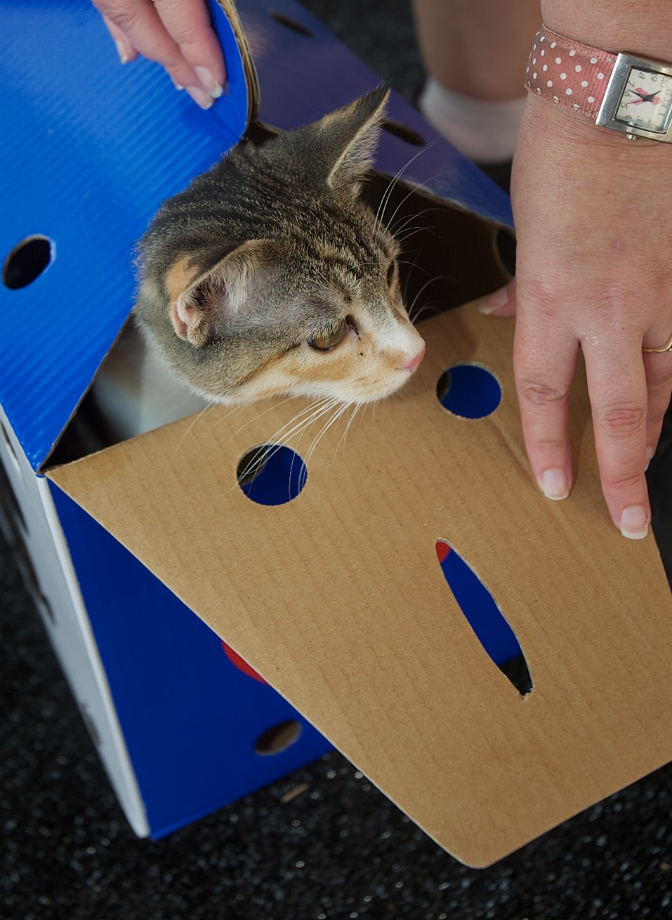
CAT TRANSITIONS & INTRODUCTIONS
Helping Cats
Adjust
to New Homes
Kit Jenkins
October 2014

Slide 2
TODAY:
DEFINE what helps cats feel safe
IDENTIFY ways to provide safety in a new situation
EXPLORE effective tactics in those categories
Awareness,
Identification, Action

Slide 3
Change is Hard
Cats are most comfortable with the familiar.
When we introduce a cat into a new situation, what important “familiar” elements has he lost?

Slide 4
Cat Priorities…
Territory
Hiding places, perches, other prime real estate
Routines, rhythms
Smells
Sounds
Relationships (even if negative or neutral)
Food & litter, bowls & boxes…including their safe location

Slide 5
Cats Feel Safe & Sane with…
Ability to make location choices:
in, under, between, behind, up, toward, away
Non-threatening environment:
sound, smell, sights
Predictable, reliable:
routine, rhythms, relationships
Manipulate/control environment:
something to do, to change, to watch

Slide 6
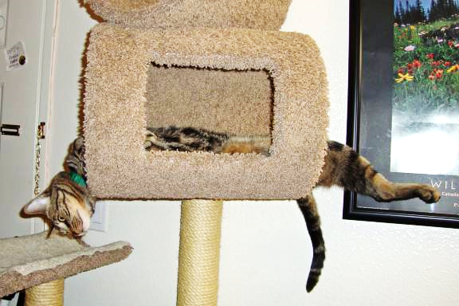
Prime real estate: 2-meter perch providing UP, ON, IN, UNDER, & AWAY from kittens…

Slide 7
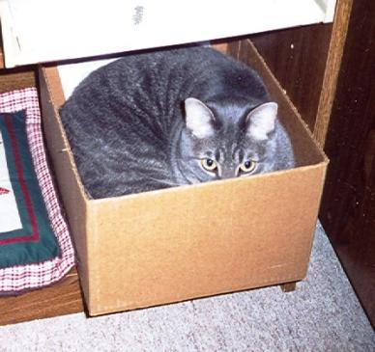
Hiding (feeling “enclosed”) helps cats cope.
Or sometimes it’s just a nice, safe feeling.
What turns “hiding” into “trapped”?

Slide 8
Note about Resident Cats
New and Resident cats share these same priorities.
When a new pet enters the home, resident cats face stress and upheavals, too!
Address their safety issues by maintaining their routines as much as possible.

Slide 9
People Priorities…
Common complaints/issues raised just after adoption
Not friendly to people
Not friendly to other pets
Always hiding
Litter box issues
Eating issues

Slide 10
Notes on Cat-Cat Relationships
Snoopy & Robin ignoring each other
Success = Not actively unhappy with each other
A snuggling, mutual-grooming relationship isn’t common.
A cat’s previous successful cat relationship doesn’t guarantee another.
Sharing space and resources as a “neutral” agreement is satisfactory.
Primary issue: Competition (real or perceived) for resources: prime real estate, lap time, role in household hierarchy, etc.
Also common issues: Differences in activity levels and social skills.

Slide 11
7 ELEMENTS FOR SUCCESSFUL TRANSITION
Establish realistic expectations re: timelines and relationships
Address any medical concerns or cautions
Set up new cat in “safe-room”
Expose to sounds, then smells, then space, then…
Eventually allow supervised face-time with resident pets
Supervise, observe, interrupt, distract, intervene as required
Be patient -- timelines vary

Slide 12
MANAGING ADOPTER EXPECTATIONS
At point of adoption:
Any medical cautions, vet visit, quarantine, etc.
Realistic timeline for adjustment
Room set-up to isolate
Suggestions re: litter and food
Reality check re: cat-cat relationships

Slide 13
To take home:
Tips, tools, tactics in writing
Provide on your website, as well
Include pet-to-pet cautions; displays vs. aggression; when/how to intervene
Take care when describing what may or may not be dangerous
3-5 days after adoption:
Follow-up call or email; “How’s it going?”
Referrals and resources to assist

Slide 14
Notes on the Waiting Game
Transition timelines vary: days or weeks
New cat’s previous experiences and patience
General household chaos; safe-room security
Timelines for pet-pet intros also vary widely
Resident pets’ age, gender, role in household
All pets’ “sharing” experience
All pets’ basic social preferences

Slide 15
Meanwhile…
Spend time on safe-room floor
Bring wet food or treats.
Relax, talk, read aloud for a few minutes.
Let the cat come to you. Don’t touch unless invited.

Slide 16
GOING HOME: Initial Set-up
Address any medical cautions, vet visit, quarantine, etc.
Release directly into prepared “safe-room” with door
Hiding spaces available, but human-accessible
Water, dry food
Litter box; same (or mixed with) previous type
Scratcher and a few toys; perch or windowsill, if possible
Dirty laundry…see next

Slide 17
DAY 1: Swapping and Mingling Scents
Provide dirty laundry (human scent)
Ideal: soft t-shirts or sleep shirts – freshly worn
Rub down cat with object to mingle scents.
Leave in safe-room near food; refresh every couple of days.
If possible, also keep some cat-scented item from previous environment
If there are resident pets
Rub down new cat with dirty laundry; provide to resident pets.
Rub down resident pets with small towel; place that item in safe-room.
Refresh both every couple of days.

Slide 18
DAY 2: Continue to work with smells and mutual comfort
If seeing lots of cat stress, consider synthetic feline pheromones.
Easy, non-invasive comfort to many cats in different kinds of transition
Plug-in version (Feliway from Comfort Zone) lasts a month for a 2-room area.
Begin pet-pet introductions -- door closed
Feed new and resident pets on opposite sides of door.
“Pussy-foot” games under the door are fine.
Panicked “must get under there” paws and yowls are not.
If resident pets (especially dogs) are too insistent, distract and remove.

Slide 19
WHEN READY: Swap rooms
When new cat is no longer hiding (comes out to you when you enter the room), allow some exploration.
Confine resident pets away from target area.
Allow new cat 15-30 minutes to explore 1 or 2 rooms. Face marking is a good sign.
It’s too soon if: he simply runs for a new hiding place and stays there.
Allow resident pets to explore safe-room (door closed). Watch out for possible urine marking and interrupt immediately.
Repeat explorations each day until all pets seem relaxed in those areas.

Slide 20
WHEN READY: Supervised face-time with cats
When new cat is confident in other areas and resident cats no longer react to safe-room.
Shut off all rooms except target area and safe-room (access for retreat).
Choose calm time when resident cats are relaxed in target area.
Best: Allow new cat to walk in, rather than carried.
Sit or stand nearby. Don’t touch either cat.
Noise is normal and okay; chasing is not.

Slide 21
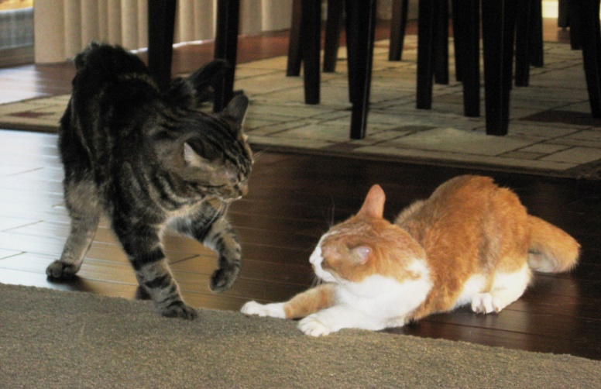
When to Intervene
Be prepared with water bottle and large towel.
Some posturing is normal, along with growls and hisses.
It’s really about each cat’s perception: “Is it a serious threat? Do I need to defend? Need to flee? Just ignore it?”
If it’s just bluster, no worries.
If both cats stand their ground and it goes no further.
If one cat runs and the other doesn’t seriously pursue.
However, be alert. Things can change in a moment.

Slide 22
Alert: Inexperienced cats tend to mis-read intentions and reactions
If they engage, interrupt. They don’t know each other well enough for it to be just rough play.
Intervene if: Yowls not growls; one cat pinned or trapped; one cat trying to escape; serious fast pursuit, etc.
Don’t touch, or punish, either cat. Interrupt with water or loud clap.
Herd new cat to safe-room, flapping a towel.
Allow both to calm down before approaching.
The longer that takes, the longer you should wait t before trying again.

Slide 23
Notes on Dogs
Yes, some cat and dogs can live together successfully.
An obedience brush-up is enough control.
No, not all dogs are safe around cats.
Some prey drives are too instinctive and intense.
Some mis-read body language as play.
Some play too roughly for safety.
Many dogs are “supervision only” around cats.
Supervising person needs strong dog experience.

Slide 24
WHEN READY: Brief supervised face-time with dogs
When new cat is confident in other areas, resident dog no longer reacts to safe-room, and “under door” interactions are low-key or absent.
Shut off all rooms except target area and safe-room (access for retreat).
Choose calm time when both pets are relaxed. Remove other pets from area.
Dog on leash, in sit- or down-stay. Reinforce verbally if necessary, but don’t punish. Reward quiet/relaxed with treats.
Best: Allow new cat to walk in, rather than carried. Second person supervising cat across the room and providing treats for calm response.

Slide 25
When to Intervene
Be prepared with water bottle and large towel.
Some cat posturing and vocalizing is normal. Again, cat’s reactions will be based on perceptions.
Be alert to dog’s reaction: rigid and intense, or loose and playful? Does that change when cat moves quickly?
If dog erupts, herd cat into safe-room and remove dog from room. Don’t punish either pet.

Slide 26
Great training DVDs for reading cat and dog language:
“What Is My Cat Saying? Feline Communication 101”
“What Is My Dog Saying?” and “What Is My Dog Saying at the Dog Park?”
For sale on www.Dogwise.com
Carol Byrnes
Over 100 video clips and photos on each Powerpoint DVD. Built for professionals to use for training.

Slide 27
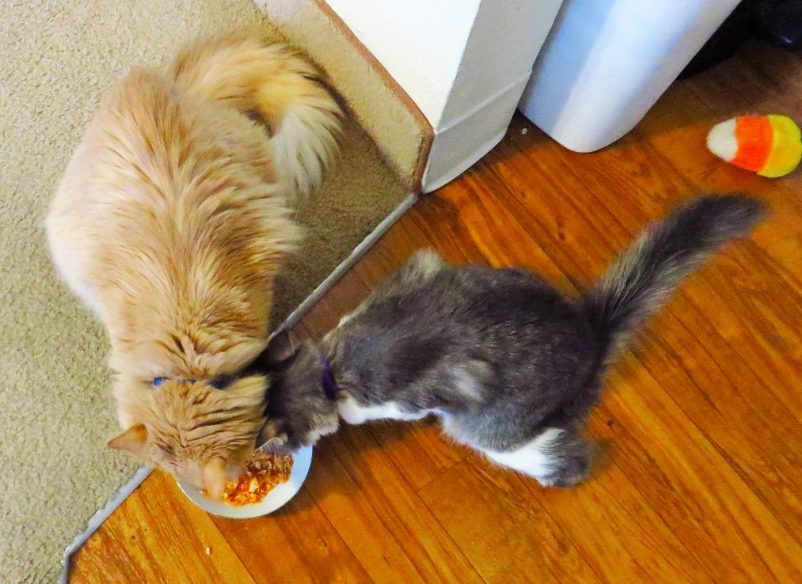
WHEN READY: An open safe-room door
If no other pets:
When new cat explores other areas with confidence.
If you’re uncertain (or it’s a large house), return cat to safe-room when unsupervised until you’re comfortable.
With resident pets:
Only when confident that all pets are safe when unsupervised.
In general:
Be sure new cat has access to safe-room as familiar retreat.

Slide 28
Notes on Litter Boxes
In general:
A box for every cat, more if a large home.
Once safe-room is open, gradually move that box toward its permanent location (a couple of feet each day).
A kitten may need more time in isolation with that box for ready access (memory and distance).
Be diligent for several weeks about ambushes and traps around boxes. If you have covered boxes, remove the lids.
If there are resident dogs:
To eliminate “snacking” from boxes, you may have to devise dog-proof blockades. Consider dog’s height and cat’s access needs.

Slide 29
7 ELEMENTS FOR SUCCESSFUL TRANSITION
Establish realistic expectations re: timelines and relationships
Address any medical concerns or cautions
Set up new cat in “safe-room”
Expose to sounds, then smells, then space, then…
Eventually allow supervised face-time with resident pets
Supervise, observe, interrupt, distract, intervene as required
Be patient -- timelines vary

Slide 30
Tip sheets available on this topic next week –
on conference site or by email inquiry.
Kit Jenkins
kjenkins@petsmartcharities.org
1/800-738-1385 x2837

Slide 31
Great webinars and other free tools and trainings at
www.petsmartcharities.org/pro/learn
www.aspcapro.org
Kit Jenkins
kjenkins@petsmartcharities.org
1/800-738-1385 x2837

